Slide 1

DEPARTMENT OF COMPUTER ENGINEERING
LeadMind : Multi-Agent AI for Sales Engagement
Student name: Aditya Maskare Roll no: 102 Division: B
Student name: Vinayak Maurya Roll no: 103 Division: B
Student name: Abhishek Mishra Roll no: 108 Division: B
Student name: Aryan Mhaskar Roll no: 106 Division: B
Under the Guidance of: Prof. Arathi Kamble

Slide 2
Problem statement
Objective
Modern outbound sales fail by using a "spray and pray" approach, sending generic messages that ignore a prospect’s specific needs and timing. Without real-time behavioral data, sales teams waste resources chasing low-intent leads who have no interest in buying. This lack of personalization causes prospects to tune out, leading to ignored outreach and stagnant pipelines. Ultimately, companies lose revenue by guessing who to target rather than using data to identify true buyer intent.
Automated Intelligence: To automate lead segmentation and intent scoring using a hybrid approach of LLM reasoning and data-driven heuristics.​
Hyper-Personalization: To generate tailored sales emails based on industry-specific data and real-time behavioral signals.​
Efficiency Optimization: To determine the optimal follow-up timing to maximize engagement and minimize prospect "nudge fatigue.“​
Scalable Architecture: To build a modular agentic workflow using LangGraph that integrates seamlessly with CRM systems.
LeadMind

Slide 3
Scope
Hyper-Personalization Engine: Generating tailored messaging for different personas and industries using AI, ensuring every touchpoint feels manual and researched.​
Behavioral Intent Tracking: Monitoring real-time signals such as email opens, link clicks, and website visits to score prospect interest levels dynamically.​
Multi-Channel Orchestration: Coordinating touchpoints across Email, LinkedIn, and targeted display ads to create an unified brand presence.​
Automated Iteration (A/B Testing): Systematically testing subject lines, call-to-actions, and sending times to identify and scale the highest-converting strategies.​
CRM Hygiene & Synchronization: Real-time updating of lead statuses, interaction history, and "do-not-contact" lists to prevent manual entry errors and sales overlap.​
Predictive Revenue Analytics: Providing dashboards that forecast pipeline growth based on current engagement rates and lead quality.
LeadMind

Slide 4
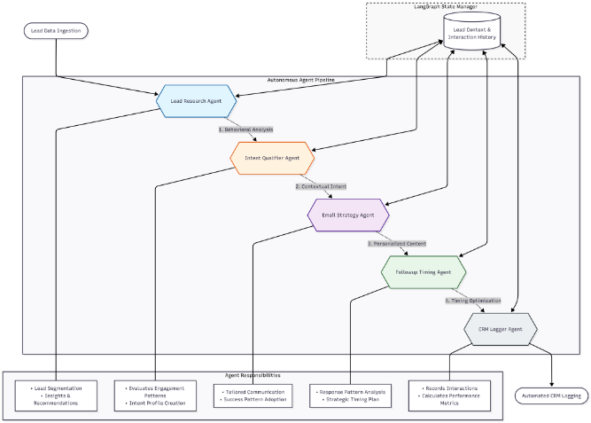
Architecture Diagram
LeadMind

Slide 5
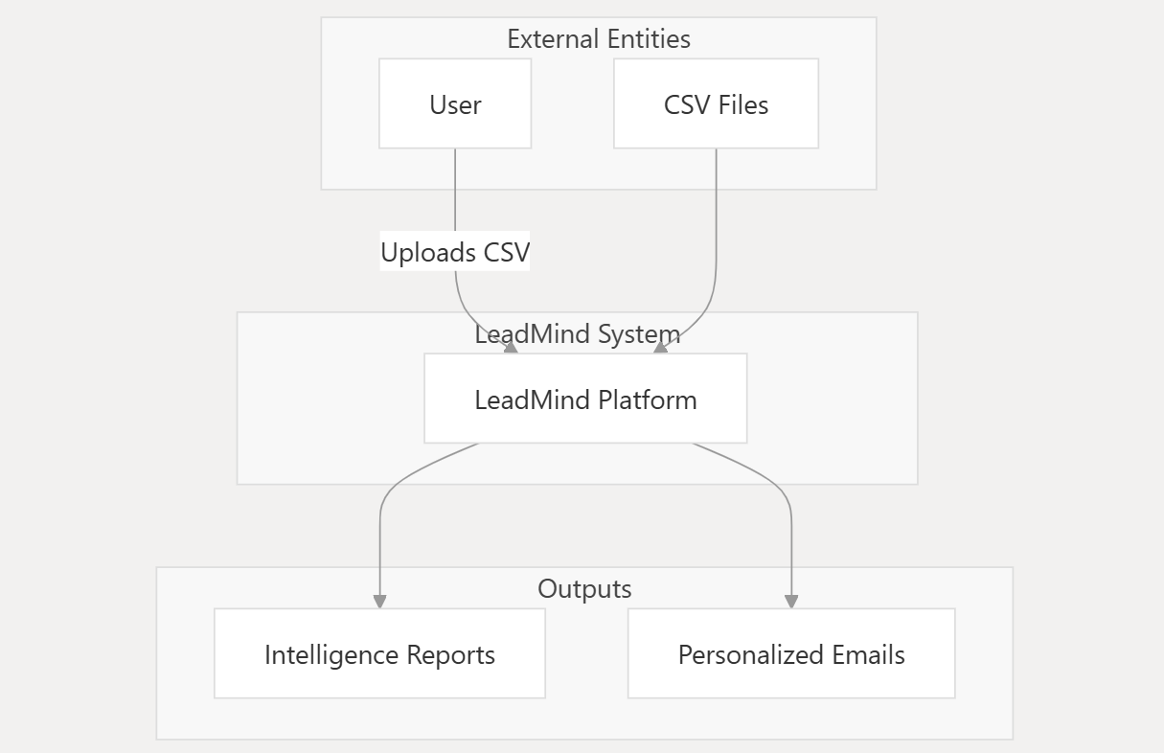
Data Flow Diagram – DFD Level 0
LeadMind

Slide 6
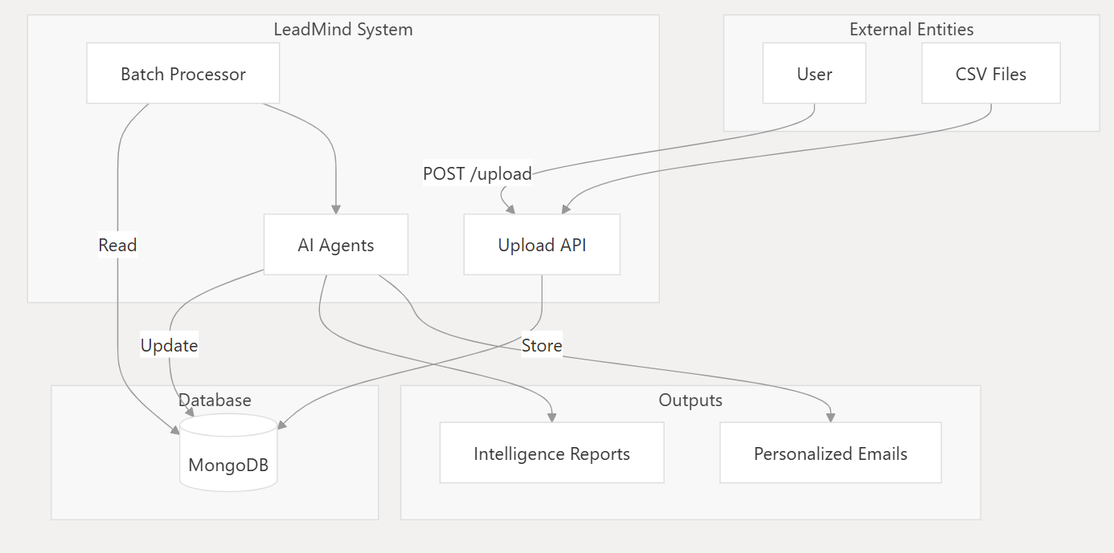
Data Flow Diagram – DFD Level 1
LeadMind

Slide 7
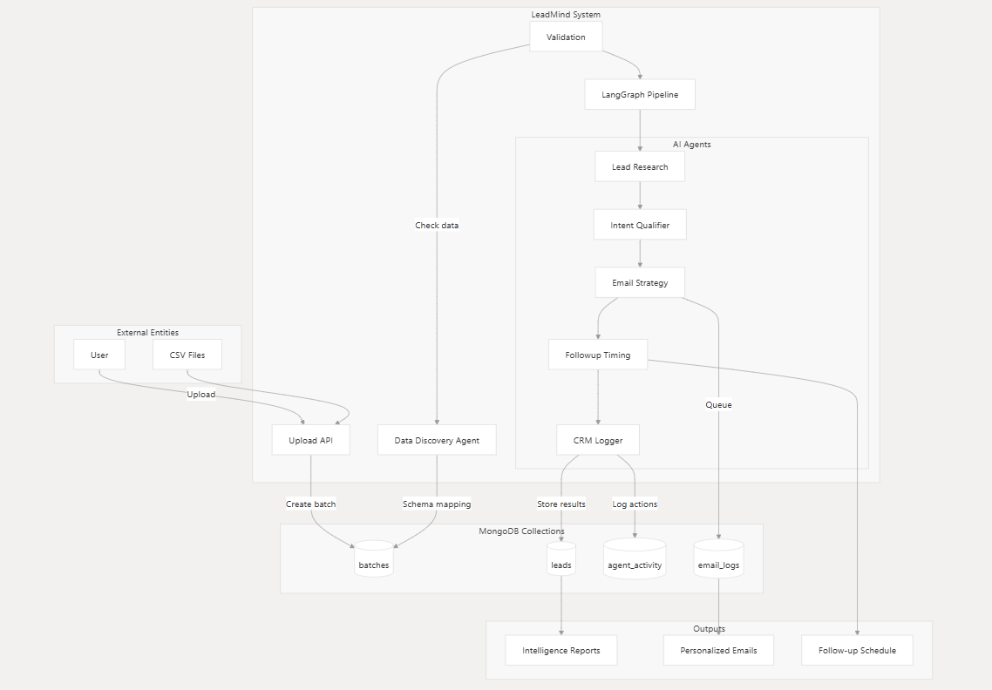
Data Flow Diagram – DFD Level 2
LeadMind

Slide 8
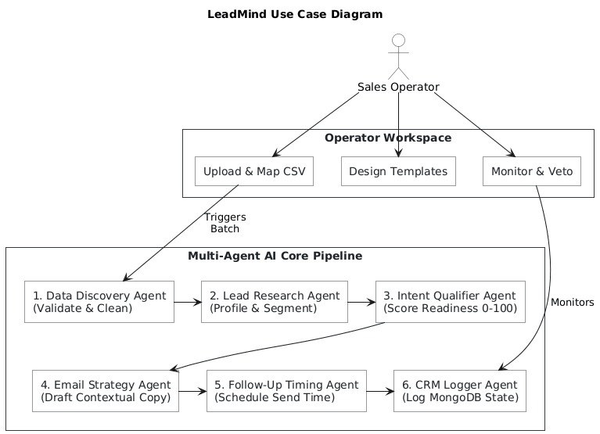
Use Case Diagram
LeadMind

Slide 9
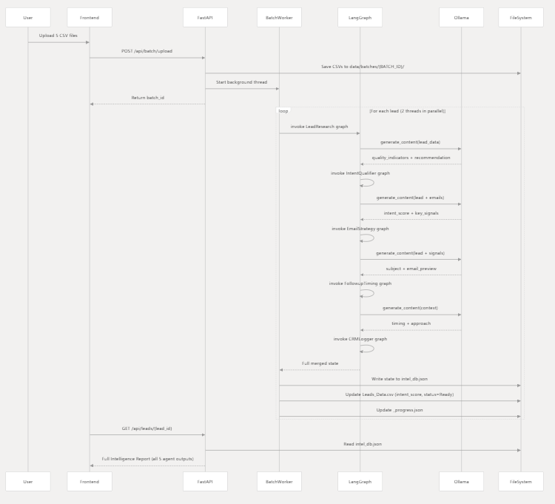
Activity Diagram
LeadMind

Slide 10
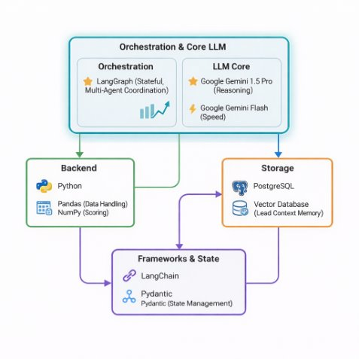
Tech Stack​
Orchestration: LangGraph (stateful,multi-agent coordination)​
LLM Core: Google Gemini 1.5 Pro(reasoning) & Gemini 1.5 Flash (speed)​ or ollama
Backend: Python (Pandas for data handling, NumPy for scoring)​
Storage: PostgreSQL + Vector Database(lead/context memory) and MongoDB​
Frameworks: LangChain, Pydantic(state & schema management)​
LeadMind

Slide 11
SDG Goals
Goal 8: Decent Work and Economic Growth: Enhancing economic productivity through technological innovation and automation of repetitive research tasks.​
Goal 9: Industry, Innovation, and Infrastructure: Fostering innovation in sales operations and data processing infrastructures using state-of-the-art Multi-Agent Systems.
LeadMind

Slide 12
Literature Survey
Sr No. | Project title | Technical approach | Algorithm/ Techniques | Key findings | Limitations | Future Scope
1 | Multi-Agent Collaboration Mechanisms: A Survey of LLMs (2025) | Survey of coordination strategies among multiple LLM agents | Multi-agent planning, task delegation, consensus mechanisms | Demonstrates improved task efficiency using agent collaboration | High orchestration complexity | Standardized frameworks for scalable agent coordination
2 | AutoGen: Enabling Next-Gen LLM Applications via Multi-Agent Conversation (2023) | Conversational multi-agent framework for task automation | Agent-to-agent communication, role-based reasoning | Enables complex workflows through agent collaboration | Requires careful prompt and role design | Improved reliability and real-world deployment
3 | LangGraph: Architecting Stateful Multi-Agent Workflows (2024) | Graph-based stateful orchestration of LLM agents | LangGraph, DAG-based workflows | Supports scalable and modular agentic systems | Steep learning curve | Simplified abstractions for business use cases
4 | asLLR: LLM-based Leads Ranking in Auto Sales (2025) | Lead ranking using LLM reasoning and customer data | LLM-based scoring, feature reasoning | Improves lead prioritization accuracy | Domain-specific implementation | Generalized lead scoring across industries
5 | The Relevance of Lead Prioritization: A B2B Lead Scoring Model based on Machine Learning (2025) | Data-driven ML-based lead scoring | Classification models, feature weighting | ML improves sales efficiency by focusing on high-intent leads | Requires large historical datasets | Hybrid ML + LLM scoring models
LeadMind

Slide 13
Sr No. | Project title | Technical approach | Algorithm/ Techniques | Key findings | Limitations | Future Scope
6 | Intent Recognition and Out-of-Scope Detection using LLMs (2025) | Intent classification using LLMs | NLP, intent classification, semantic analysis | Accurate detection of buyer intent | Struggles with ambiguous inputs | Context-aware intent detection
7 | The Role of AI Nudges in Optimizing Consumer Behavior (2025) | Behavioral analysis using AI-driven nudges | Reinforcement learning, behavioral modeling | Optimized follow-ups increase engagement | Risk of user fatigue | Adaptive and ethical nudge systems
8 | Understanding Customer Responses to AI-Driven Personalized Journeys (2025) | Analysis of personalization impact on customers | Personalization algorithms, customer journey modeling | Personalized outreach improves response rates | Privacy concerns | Privacy-preserving personalization
9 | The Algorithmic Persuader: Ethical Challenges in AI-Powered Digital Marketing (2025) | Ethical evaluation of AI-driven persuasion | Ethical AI frameworks | Highlights risks of manipulation and bias | Limited technical mitigation strategies | Responsible AI governance models
10 | How AI Agents Will Transform B2B Sales (2025) | Conceptual study of AI agents in sales automation | Autonomous agents, CRM integration | AI agents can automate and optimize sales pipelines | Early-stage adoption | Production-ready agentic sales systems
LeadMind

Slide 14
Expected Outcome
Engagement: Expected 25%+ increase in email open and response rates.​
Time Savings: 80% reduction in manual time spent on lead qualification.​
Optimization: Improved "Meeting Booked" ratio through data-driven​ timing.​
System Integrity: A robust, error-correcting agentic pipeline that logs all activities to a CRM.​
LeadMind

Slide 15
References 1
Sales Research Bench: Technical Paper (2025)​
Authors: Microsoft Dynamics 365 AI Research Team.​
Summary: This paper introduces a specialized benchmark for evaluating "Sales Research Agents." It details a multi-agent infrastructure that orchestrates lead blueprints, text narratives, and data visualizations with a focus on "Schema Accuracy" and "Text Groundedness"
LeadMind

Slide 16
References 2
Multi-Agent Collaboration Mechanisms: A Survey of LLMs (2025)​
Authors: J. Nie, B. Zhang, et al. (University of Montreal / arXiv).​
Summary: An extensive survey providing a framework for how LLM-based agents transition from isolated models to collaborative systems. It categorizes coordination protocols and strategies essential for modular workflows like your proposed project.​
LeadMind

Slide 17
References 3
LangGraph for Multi-Agent Workflows in Enterprise AI (2025)​
Author: Royal Cyber AI/ML Research Group.​
Summary: This research focuses on using LangGraph to build state machines for persistent memory in sales workflows. It explains how to design "State Schemas" and "Conditional Edges" to manage human-in-the-loop sales interactions.​
LeadMind

Slide 18
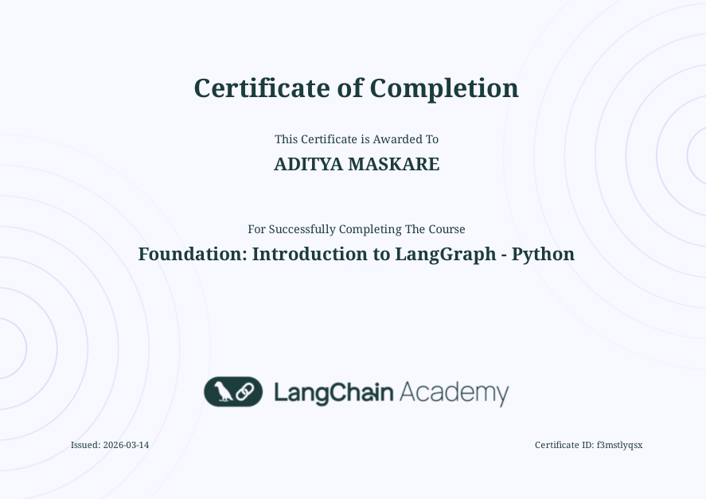

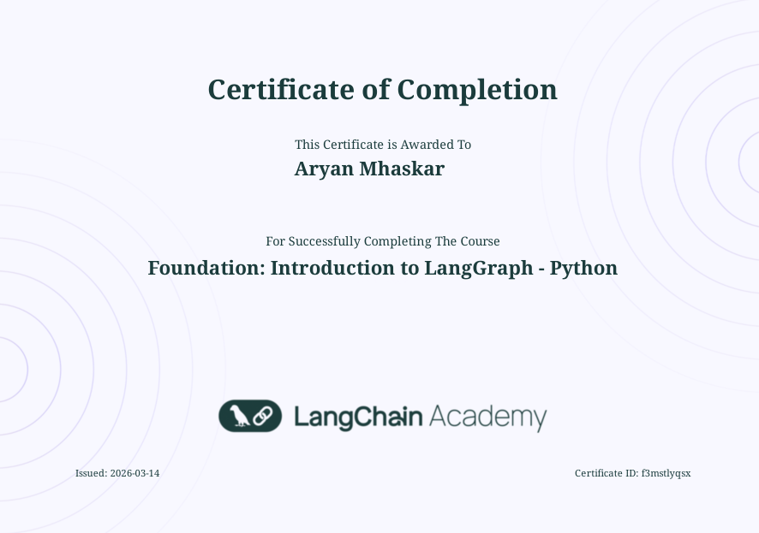

Certifications
LeadMind

Slide 19


